Slide 1
Face Recognition
Design a classifier to recognize face images
Team Cortes
August 2017

Slide 2












The problem:
WHO is this?
Objective: design a classifier to recognize these face images.

Slide 3
The flow of data:
Data Collection
Testing and training data split
Pick the winning model !
PCA
Modeling
Linear, Gaussian, Ensemble etc.
Black arrow: flow of training data
Red arrow: flow of testing data
Evaluation matrix

Slide 4
Data Collection Results
Collect face images using opencv package
100 images per class, 6 classes
Class labels:
Priyanka Deo 0
Weiya Jiang 1
Nicolas Loffreda 2
Krupa Masilamani 3
Mukul Sharma 4
Laura Ye 5

Slide 5
Statistics of testing and training data splits
Training data: 75% data (444 samples)
Testing data: 25% data (147 samples)
Randomized samples
Sample counts in each class of training data:
(class_id: sample counts)
0: 68, 1: 74, 2: 73, 3: 79, 4: 80, 5: 70

Slide 6
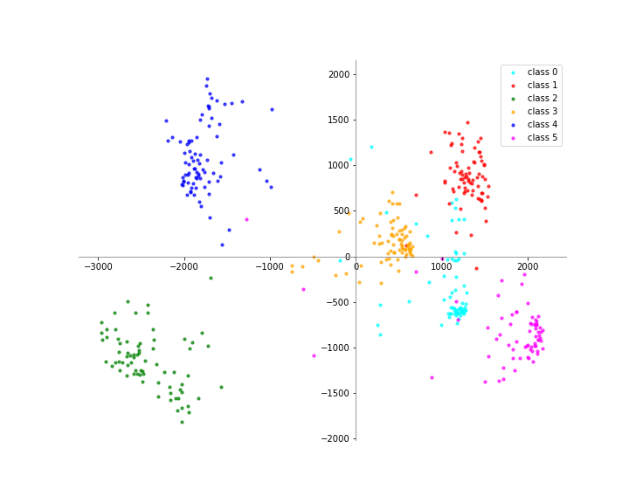
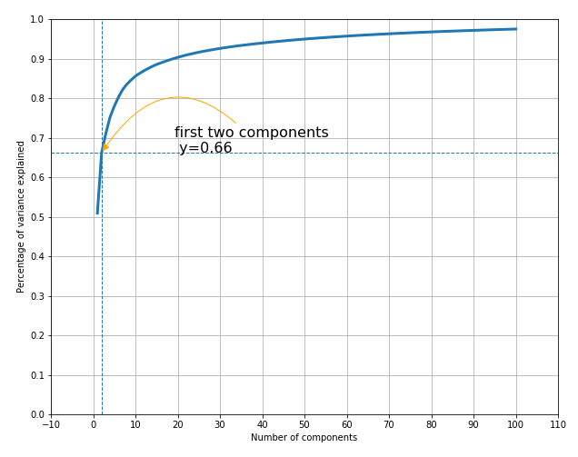
PCA Results
PCA on training data (2500 -> 2 dims)

Slide 7
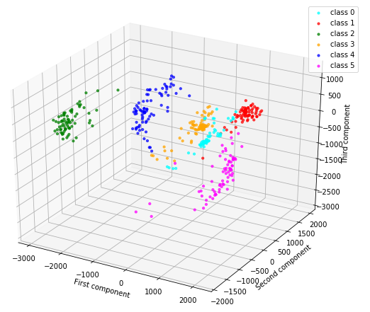
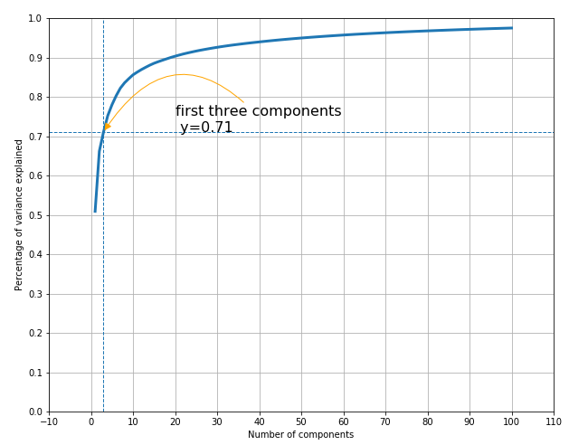
PCA Results
PCA on training data (2500 -> 3 dims)

Slide 8
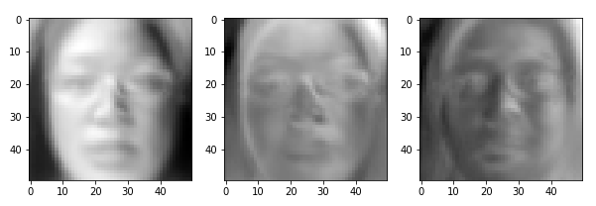
PCA Results
First three Eigenfaces

Slide 9
Models applied
Gaussian model using 2PC
Gaussian model using 3PC
Linear model using 2PC
Linear model using 3PC
Ensemble model 2PC

Slide 10
Results
Gaussian/Bayesian Model using 2PC
Confusion Matrix
Training samples
Testing samples
 | Class 0 | Class 1 | Class 2 | Class 3 | Class 4 | Class 5
Class 0 | 32 | 5 | 0 | 15 | 0 | 16
Class 1 | 1 | 70 | 0 | 3 | 0 | 0
Class 2 | 0 | 0 | 73 | 0 | 0 | 0
Class 3 | 0 | 0 | 0 | 79 | 0 | 0
Class 4 | 0 | 0 | 0 | 0 | 80 | 0
Class 5 | 4 | 0 | 1 | 3 | 1 | 61
 | Class 0 | Class 1 | Class 2 | Class 3 | Class 4 | Class 5
Class 0 | 12 | 2 | 0 | 15 | 0 | 2
Class 1 | 0 | 24 | 0 | 2 | 0 | 0
Class 2 | 0 | 0 | 23 | 0 | 0 | 0
Class 3 | 0 | 0 | 0 | 21 | 0 | 0
Class 4 | 0 | 0 | 0 | 0 | 16 | 0
Class 5 | 3 | 0 | 0 | 0 | 0 | 27
Accuracy: 0.89
Accuracy: 0.837

Slide 11
Results
Gaussian/Bayesian Model using 3PC
Confusion Matrix
Training samples
Testing samples
 | Class 0 | Class 1 | Class 2 | Class 3 | Class 4 | Class 5
Class 0 | 43 | 7 | 0 | 13 | 1 | 4
Class 1 | 1 | 69 | 0 | 3 | 0 | 1
Class 2 | 0 | 0 | 73 | 0 | 0 | 0
Class 3 | 0 | 4 | 0 | 70 | 1 | 4
Class 4 | 0 | 0 | 0 | 0 | 80 | 0
Class 5 | 18 | 0 | 0 | 0 | 1 | 51
 | Class 0 | Class 1 | Class 2 | Class 3 | Class 4 | Class 5
Class 0 | 10 | 2 | 0 | 15 | 0 | 4
Class 1 | 0 | 24 | 0 | 2 | 0 | 0
Class 2 | 0 | 0 | 23 | 0 | 0 | 0
Class 3 | 0 | 0 | 0 | 20 | 0 | 1
Class 4 | 0 | 0 | 0 | 0 | 16 | 0
Class 5 | 7 | 0 | 0 | 0 | 0 | 23
Accuracy: 0.869
Accuracy: 0.789

Slide 12
Results
Linear Model using 2PC
Confusion Matrix
Training samples
Testing samples
 | Class 0 | Class 1 | Class 2 | Class 3 | Class 4 | Class 5
Class 0 | 0 | 9 | 1 | 0 | 2 | 56
Class 1 | 0 | 73 | 0 | 0 | 0 | 1
Class 2 | 0 | 0 | 73 | 0 | 0 | 0
Class 3 | 0 | 57 | 8 | 0 | 5 | 9
Class 4 | 0 | 0 | 0 | 0 | 80 | 0
Class 5 | 0 | 0 | 2 | 0 | 1 | 67
 | Class 0 | Class 1 | Class 2 | Class 3 | Class 4 | Class 5
Class 0 | 0 | 7 | 0 | 0 | 1 | 23
Class 1 | 0 | 25 | 0 | 0 | 0 | 1
Class 2 | 0 | 0 | 23 | 0 | 0 | 0
Class 3 | 0 | 13 | 1 | 0 | 3 | 4
Class 4 | 0 | 0 | 1 | 0 | 15 | 0
Class 5 | 0 | 0 | 0 | 0 | 0 | 30
Accuracy: 0.66
Accuracy: 0.633

Slide 13
Results
Linear Model using 3PC
Confusion Matrix
Training samples
Testing samples
 | Class 0 | Class 1 | Class 2 | Class 3 | Class 4 | Class 5
Class 0 | 4 | 19 | 0 | 0 | 2 | 43
Class 1 | 0 | 72 | 0 | 0 | 1 | 1
Class 2 | 0 | 0 | 73 | 0 | 0 | 0
Class 3 | 0 | 59 | 0 | 0 | 10 | 10
Class 4 | 0 | 0 | 0 | 0 | 80 | 0
Class 5 | 2 | 2 | 0 | 0 | 1 | 65
 | Class 0 | Class 1 | Class 2 | Class 3 | Class 4 | Class 5
Class 0 | 1 | 13 | 0 | 0 | 1 | 16
Class 1 | 0 | 23 | 0 | 0 | 1 | 2
Class 2 | 0 | 0 | 23 | 0 | 0 | 0
Class 3 | 0 | 15 | 0 | 0 | 2 | 4
Class 4 | 0 | 0 | 0 | 0 | 16 | 0
Class 5 | 2 | 2 | 0 | 0 | 0 | 26
Accuracy: 0.662
Accuracy: 0.605

Slide 14
Results
Ensemble Model, 60 linear classifiers, 2PC
Confusion Matrix
Training samples
Testing samples
 | Class 0 | Class 1 | Class 2 | Class 3 | Class 4 | Class 5
Class 0 | 64 | 1 | 0 | 3 | 0 | 0
Class 1 | 3 | 70 | 0 | 1 | 0 | 0
Class 2 | 0 | 0 | 73 | 0 | 0 | 0
Class 3 | 1 | 0 | 0 | 78 | 0 | 0
Class 4 | 0 | 0 | 0 | 1 | 79 | 0
Class 5 | 6 | 0 | 0 | 0 | 1 | 63
 | Class 0 | Class 1 | Class 2 | Class 3 | Class 4 | Class 5
Class 0 | 26 | 5 | 0 | 0 | 0 | 0
Class 1 | 3 | 23 | 0 | 0 | 0 | 0
Class 2 | 0 | 0 | 23 | 0 | 0 | 0
Class 3 | 0 | 0 | 0 | 21 | 0 | 0
Class 4 | 0 | 0 | 1 | 0 | 15 | 0
Class 5 | 1 | 0 | 0 | 0 | 0 | 29
Accuracy: 0.962
Accuracy: 0.932

Slide 15
Results
Performance comparison
 | Accuracy & PPV
 | Training data |  | Testing data
 | All class | Class 0-6 (PPV) | All class | Class 0-6 (PPV)
Gaussian Model 2PC | 0.890 | 0.471-1.000 | 0.837 | 0.387-1.000
Gaussian Model 3PC | 0.869 | 0.632-1.000 | 0.789 | 0.323-1.000
Linear Model 2PC | 0.660 | 0.000-1.000 | 0.633 | 0.000-1.000
Linear Model 3PC | 0.662 | 0.000-1.000 | 0.605 | 0.000-1.000
Ensemble model (60) | 0.962 | 0.941-1.000 | 0.932 | 0.839-1.000

Slide 16
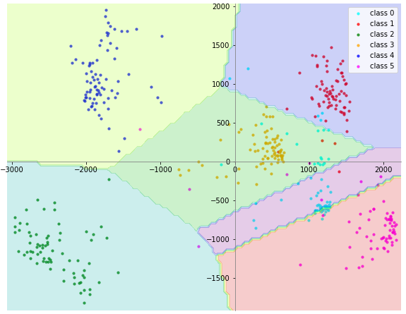
Results
Decision boundary (2D Gaussian)
Class 0 is not well separated (non-linear model may yield better separation)

Slide 17
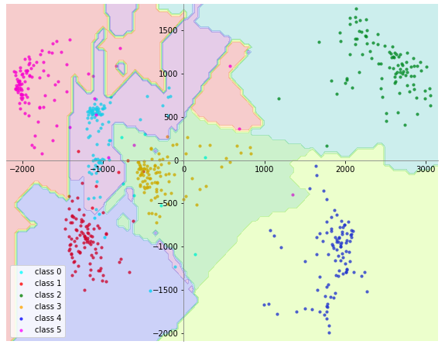
Results
Decision boundary
Ensemble model
(60 linear classifiers)
2PC

Slide 18
Discussion
male
Factors affect model performance: the effect of lighting on prediction
Caveats: unexpected male and female separation.
Female

Slide 19
Acknowledgements
Team of Cortes
Priyanka Deo
Weiya Jiang
Nicolas Loffreda
Krupa Masilamani
Mukul Sharma
Laura Ye
Special thanks to our teacher:
Shashidhar Sathyanarayana

